Slide 1
Kinematic Presentation Tom
5/19/25

Slide 2
Completed:
Velcro testing on length samples
Different way of plotting train one sample and apply model on reapplied and misaligned samples
Testing Current Source Circuit. Provides INCREDIBLY LOW NOISE DATA. Will use for PCB design but not for camera design to keep circuit consistent with bench top testing
Circuit design for 4 strain sensors
Order Camera equipment
Begin programming python code for data acquisition

Slide 3
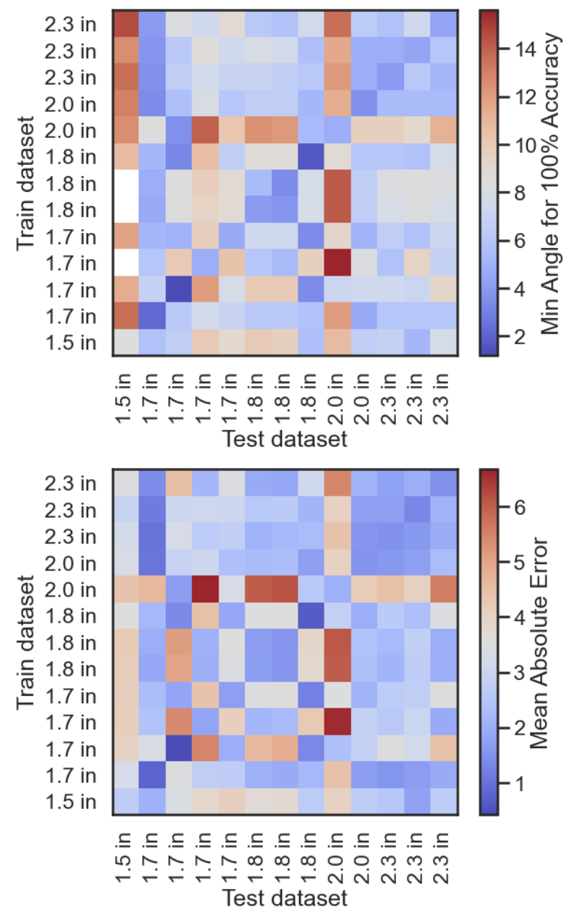
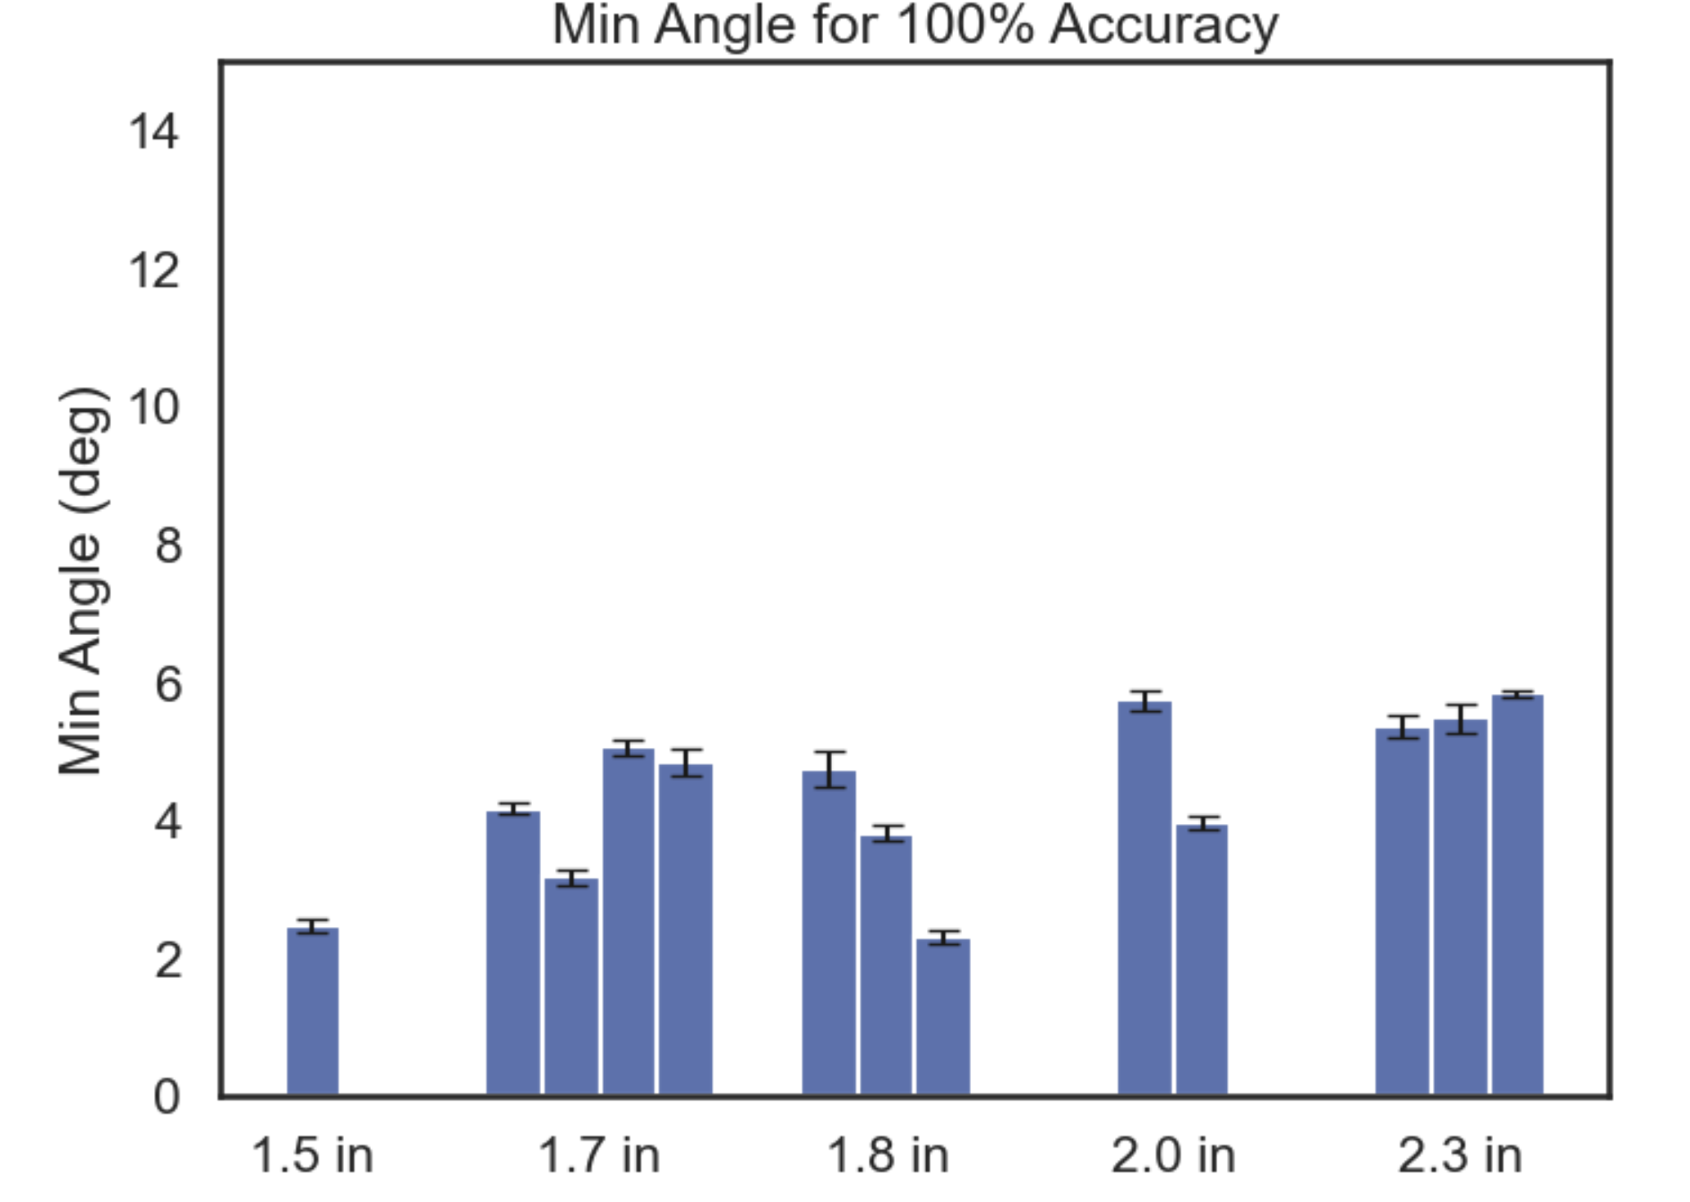
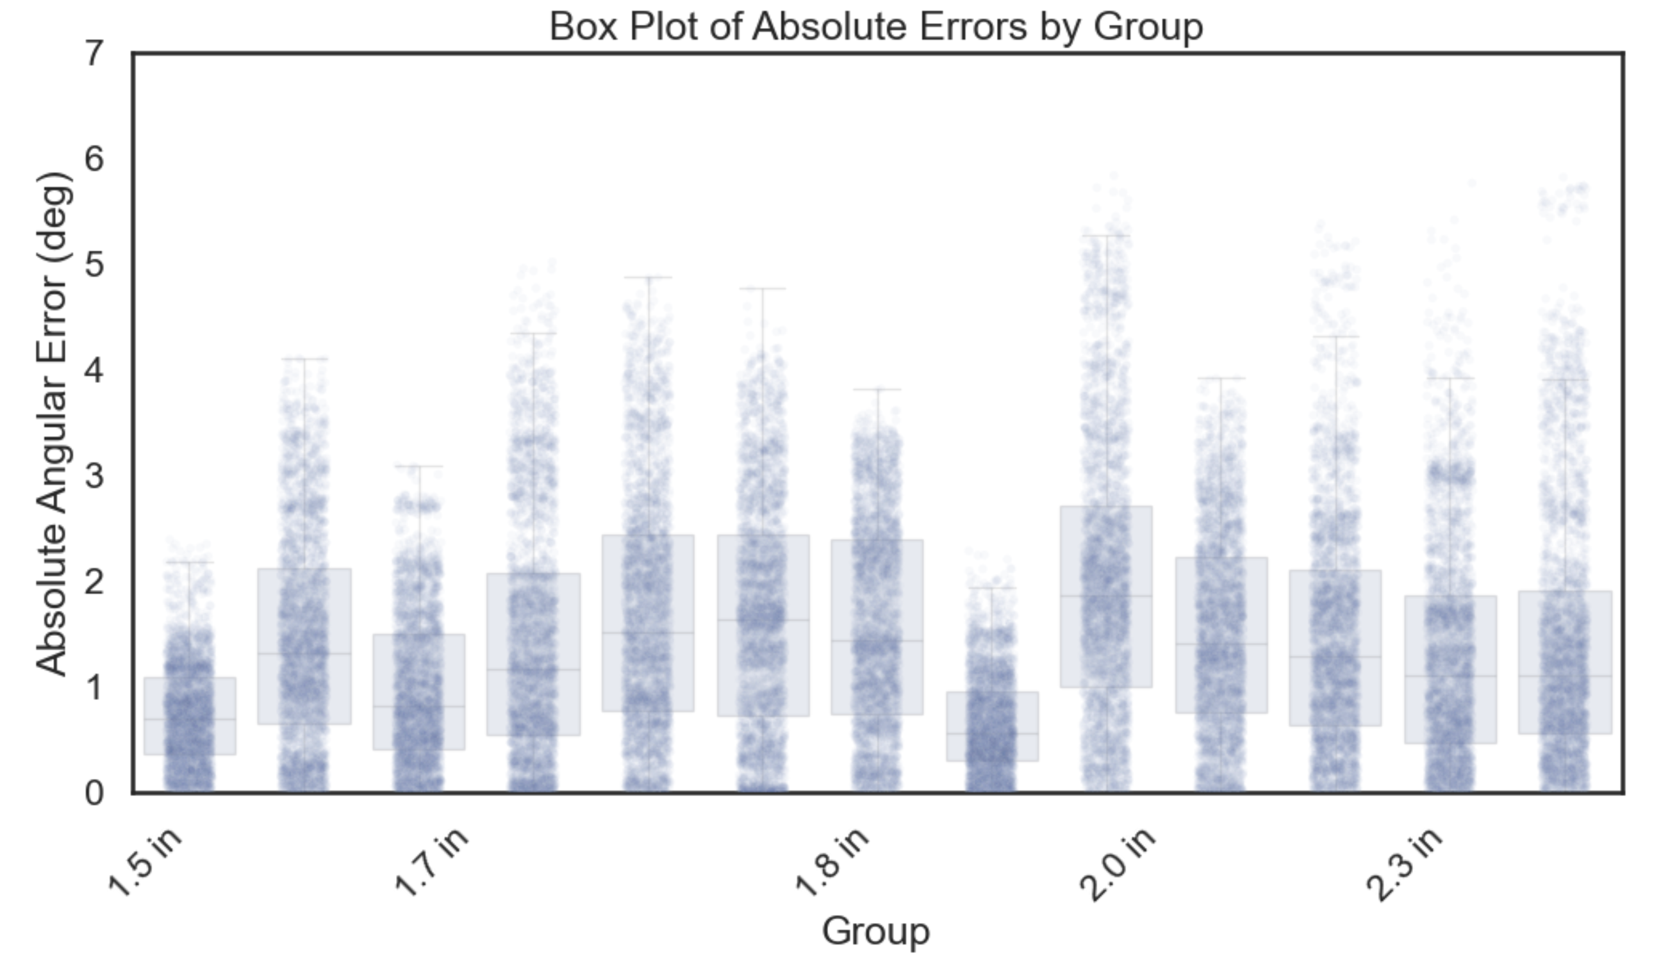
Length Data Tested Using Velcro

Slide 4
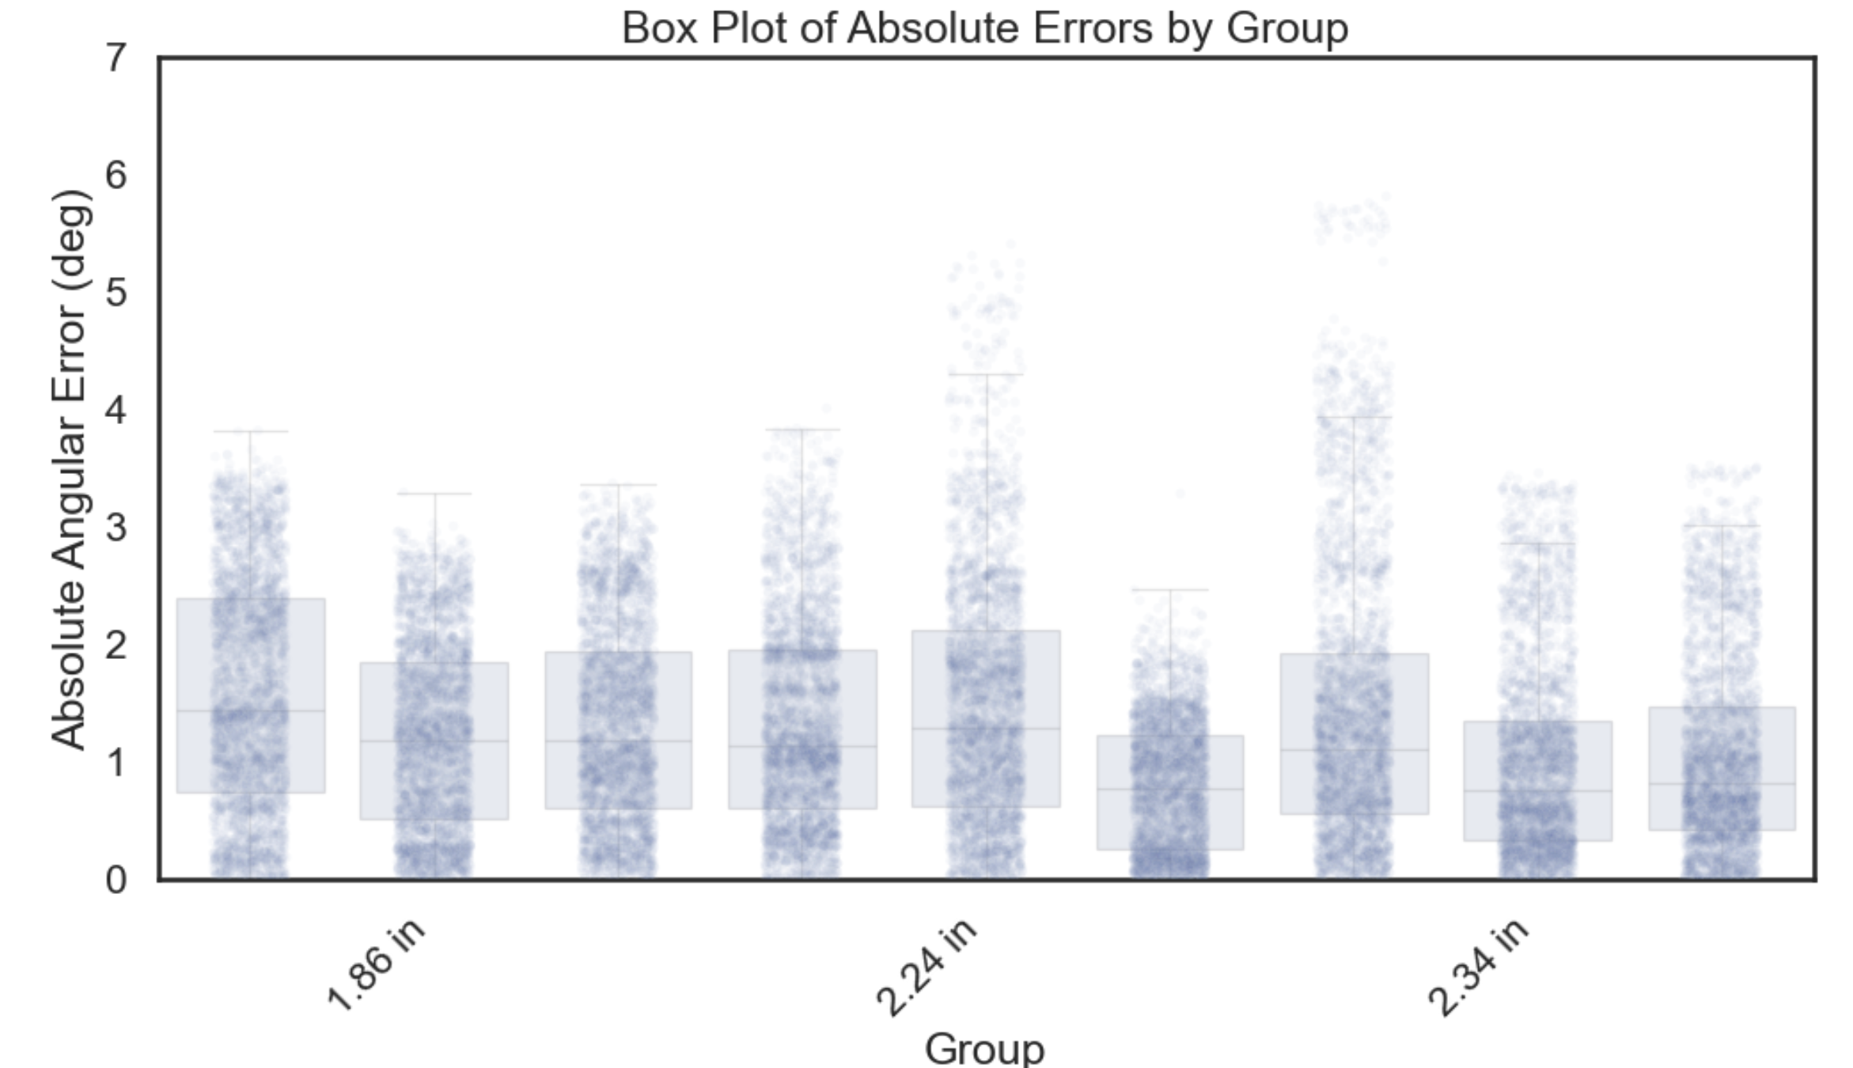
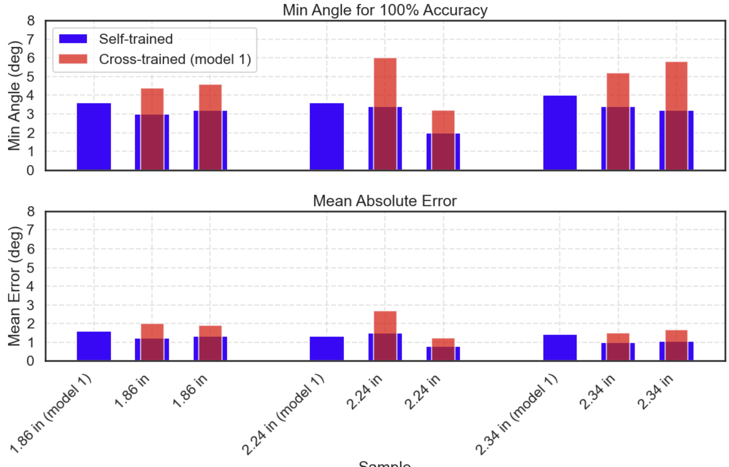
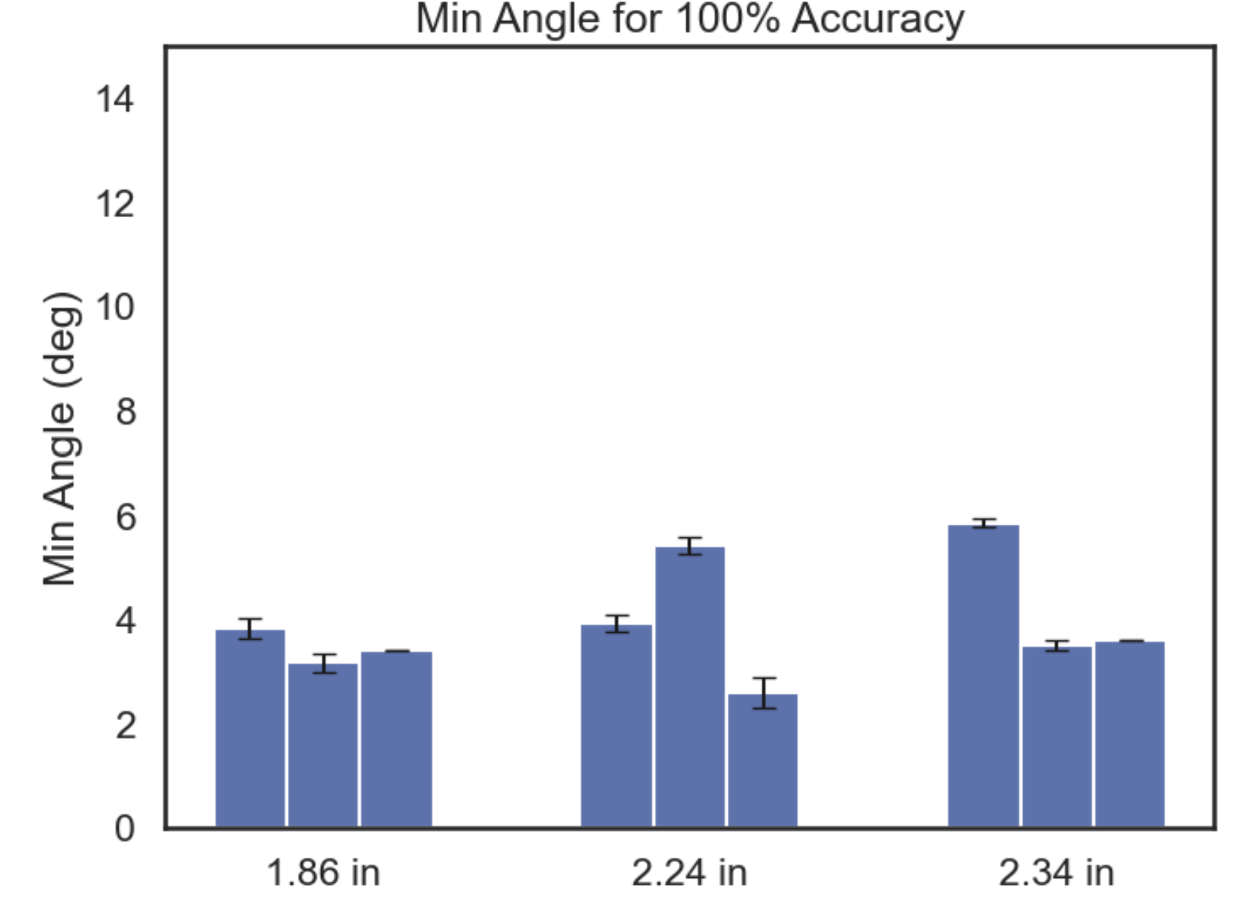
Reapplication Data Tested Using Velcro

Slide 5
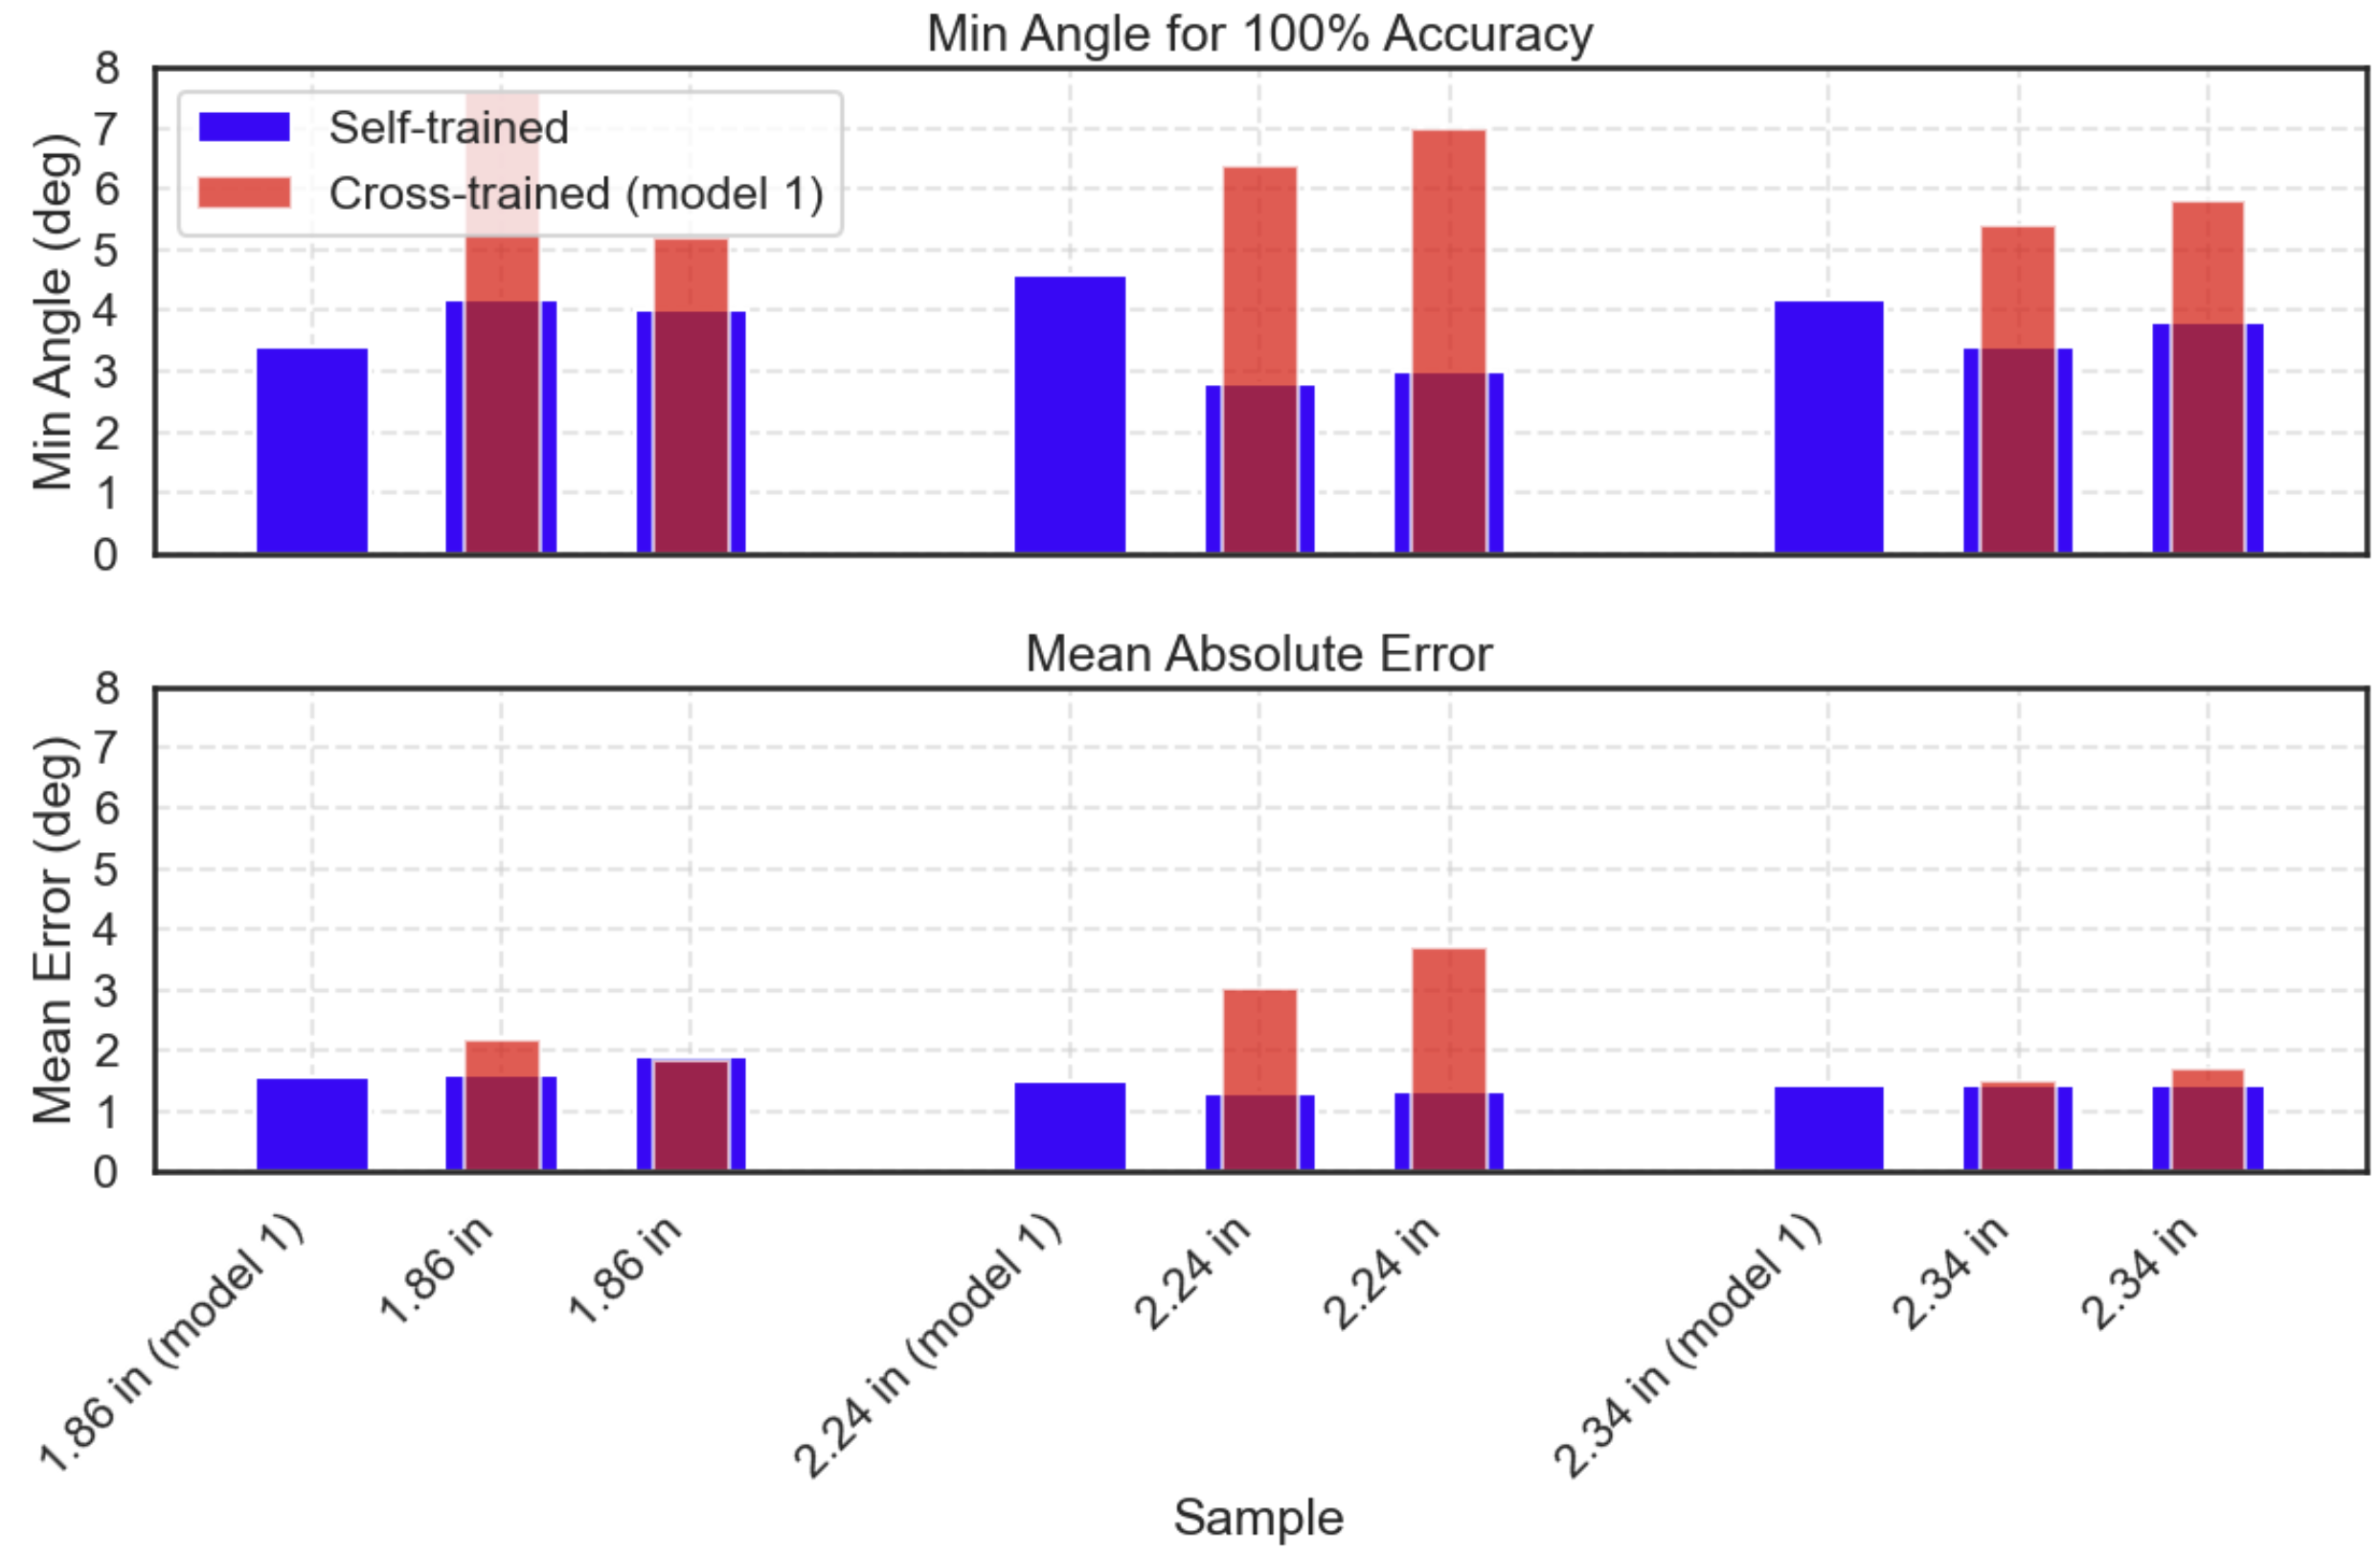
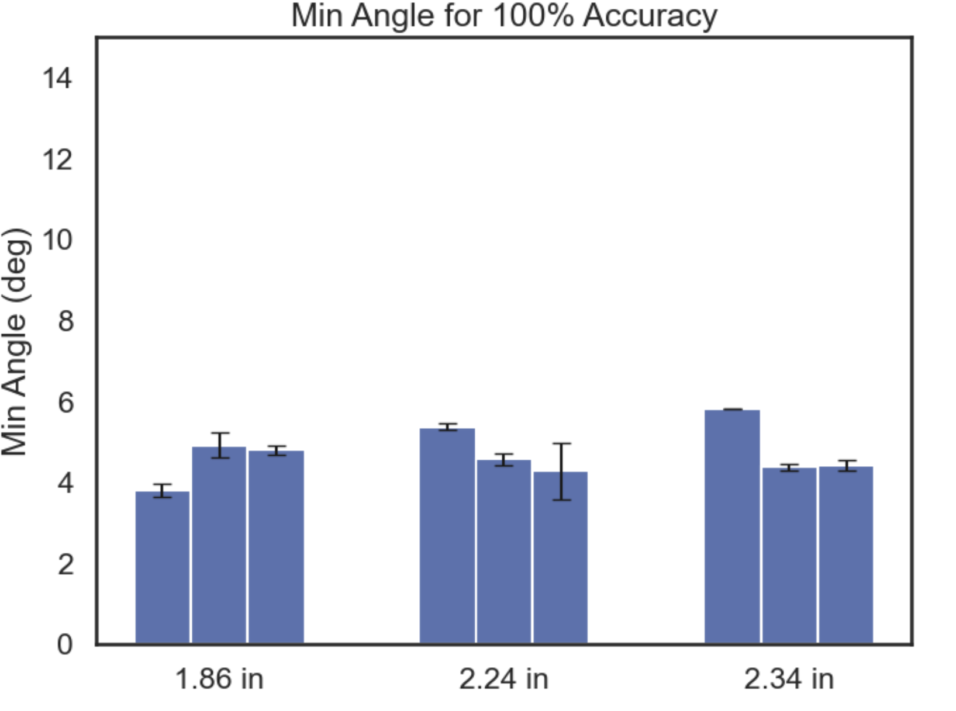
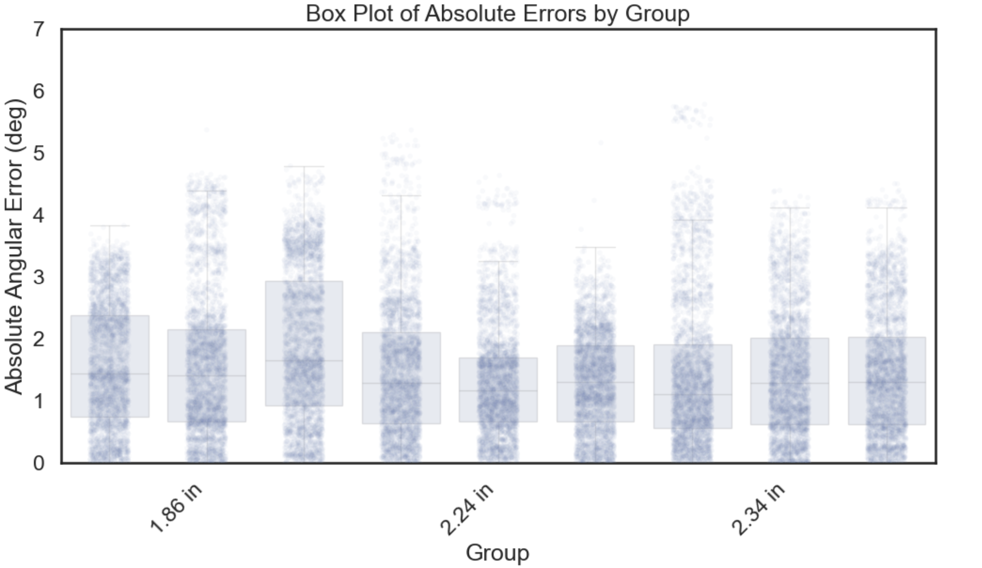
Misalignment Data Tested Using Velcro

Slide 6
To Do:
Plan was to finish making different cross-sectional area liquid metal channels today to test tomorrow: 0.017”x 0.017”, 0.02”x 0.02”, and 0.023” x 0.023”
0.01”x 0.01”, 0.02”x 0.02”, and 0.03” x 0.03”
Test new delta sigma ADC 24 bit with 128x gain possible using SPI communication protocol. If works, can use this for the PCB design since one chip can take up to 8 sensors and sampling frequency up to kHz range.
This board not needed for camera testing, just for final pcb design potentially
Order Camera equipment
Begin programming python code for data acquisition

Slide 7
Circuit V1 Option -> 7.5 mA
Strain Gauge (0.4 ohm – 1.2 ohm)
Practically no noise at rest!
GND
LT3092 7.5mA current source
(75K:100 ohm resistor ratio)
GND
OPA333
x831
2.048V ref MAX6070 (or 2.048V LM4040)
Circuit Component | Current Draw (mA)
Divider Circuit (LT3092) | ~ 7.5 mA
MAX6070 | ~ 0.2 mA
LMC6482 | ~ 0.6 mA
ADS115 or MCP3421 (16 bit) | ~ 0.22 mA
INA333 | ~0.05 mA
1.152 V –3.456V
(4mV – 11.59 mV)
GND
x2
MCP3421 I2C (16 bit resolution)
x50
Arduino

Slide 8
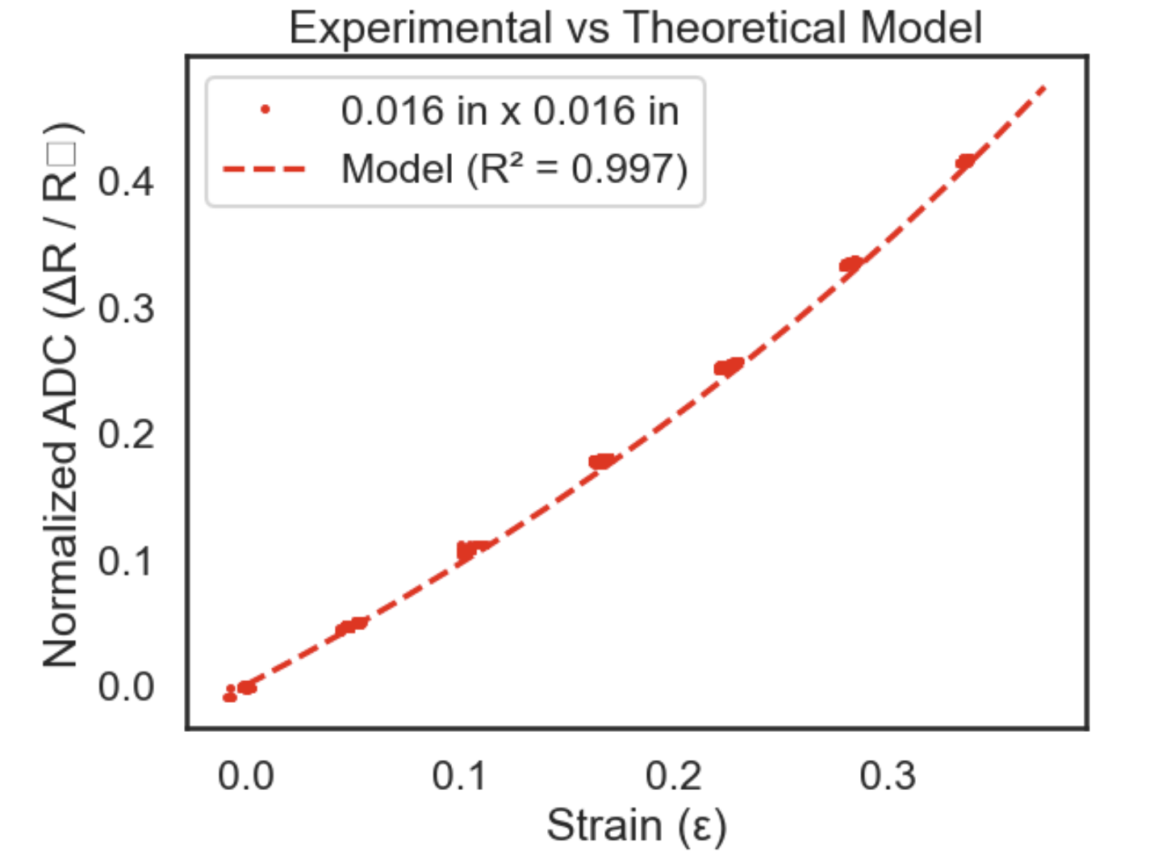
Theoretical Model vs. Channel Cross-Section

Slide 9
Circuit 5 for Camera Setup: 65 mA through each divider (can be adjusted to 15mA)
75 ohm
Strain Gauge (0.4 ohm – 1.2 ohm)
ADS115 I2C (two unique addresses 0x48, 0x49)
2.048V
GND
75 ohm
Strain Gauge (0.4 ohm – 1.2 ohm)
x 2
GND
2.048V
I2C
Rasberry Pi
75 ohm
Strain Gauge (0.4 ohm – 1.2 ohm)
GND
2.048V
75 ohm
Strain Gauge (0.4 ohm – 1.2 ohm)
x 2
GND
2.048V
ADM7150 3.3V 800 mA
X76 (LMC6482 or OPA333)
IMU
IMU
(two unique addresses, 0x28, 0x29)
GND
2.048V ref (LM4040 or MAX6070)
Circuit 5 for Camera Setup: same circuit has bench top testing with exception what ADC is ADS115, not MCP3421, to handle the higher sampling frequency at 16 bit -> 200-500 Hz

